Slide 1
N 차원 코사인 유사도를 이용한 Discriminator 구현
Team Quest
최범규, 조동기, 이영석, 박종원, 김도영
발표자 최범규

Slide 2

Definitions
Cosine Similarity
$\cos\left(a,b\right)≔ \frac{a∙b}{\left\|a\right\|\left\|b\right\|}$ → = $a∙b$
Rotation to X by θ
$R_{X(θ)}= e^{−i\frac{θ}{2}σ_{x}}=cos\frac{θ}{2}𝟙 −isin\frac{θ}{2}σ_{x}= \left(\begin{matrix}cos\frac{θ}{2} & −isin\frac{θ}{2} \\ −isin\frac{θ}{2} & cos\frac{θ}{2}\end{matrix}\right)$
(for unit vector a,b)

Slide 3

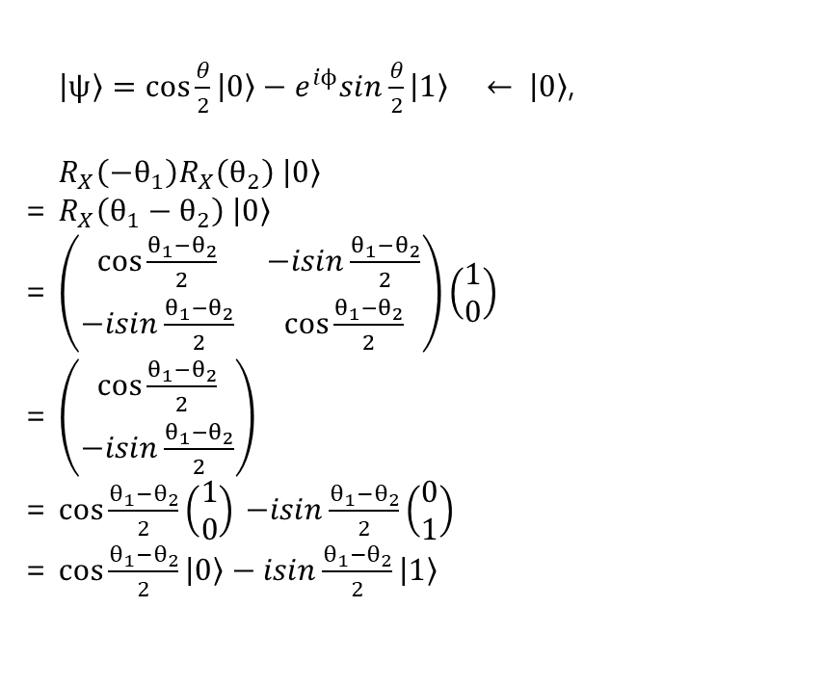
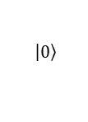
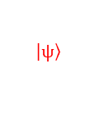
Circuit for Cosine Similarity : Derivation for 2-D
$\left.\left|ψ\right.\right\rangle =cos\frac{θ}{2}\left.\left|0\right.\right\rangle −e^{iϕ}sin\frac{θ}{2}\left.\left|1\right.\right\rangle ← \left.\left|0\right.\right\rangle$,
$R_{X}\left(−θ_{1}\right)R_{X}\left(θ_{2}\right)\left. \left|0\right.\right\rangle$
= $R_{X}\left({θ_{1}−θ}_{2}\right)\left. \left|0\right.\right\rangle$
= $\left(\begin{matrix}cos\frac{{θ_{1}−θ}_{2}}{2} & −isin\frac{{θ_{1}−θ}_{2}}{2} \\ −isin\frac{{θ_{1}−θ}_{2}}{2} & cos\frac{{θ_{1}−θ}_{2}}{2}\end{matrix}\right)\left(\begin{matrix}1 \\ 0\end{matrix}\right)$
= $\left(\begin{matrix}cos\frac{{θ_{1}−θ}_{2}}{2} \\ −isin\frac{{θ_{1}−θ}_{2}}{2}\end{matrix}\right)$
= $cos\frac{{θ_{1}−θ}_{2}}{2}\left(\begin{matrix}1 \\ 0\end{matrix}\right)$ $−isin\frac{{θ_{1}−θ}_{2}}{2}\left(\begin{matrix}0 \\ 1\end{matrix}\right)$
= $cos\frac{{θ_{1}−θ}_{2}}{2}\left.\left|0\right.\right\rangle −isin\frac{{θ_{1}−θ}_{2}}{2}\left.\left|1\right.\right\rangle$
$$\left.\left|0\right.\right\rangle$$
$$\left. \left|ψ\right.\right\rangle$$
$$\frac{{θ_{1}−θ}_{2}}{2}$$

Slide 4
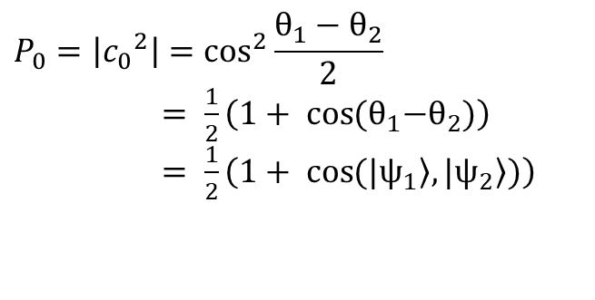


Circuit for Cosine Similarity
$$cos\frac{{θ_{1}−θ}_{2}}{2} \left.\left|0\right.\right\rangle −isin\frac{{θ_{1}−θ}_{2}}{2}\left. \left|1\right.\right\rangle$$
$$P_{0}=\left|{c_{0}}^{2}\right|=\cos^{2}\frac{{θ_{1}−θ}_{2}}{2}$$
$= \frac{1}{2}\left(1+ \cos{{{(θ}_{1}−θ}_{2})}\right)$
$= \frac{1}{2}\left(1+ \cos\left.(|ψ_{1}\right\rangle ,\left.|ψ_{2}\right\rangle )\right)$
$$\left.\left|0\right.\right\rangle$$
$$\left. \left|ψ\right.\right\rangle$$
$$\frac{{θ_{1}−θ}_{2}}{2}$$
$$P_{0}= \frac{1}{2}\left(1+\cos\left.(|ψ_{1}\right\rangle ,\left.|ψ_{2}\right\rangle )\right)$$
$$= \frac{1}{2}\left(1+\left\langle ψ_{1} | ψ_{2}\right\rangle \right)$$
$$\left\langle ψ_{1} | ψ_{2}\right\rangle = 2P_{0}−1$$

Slide 5
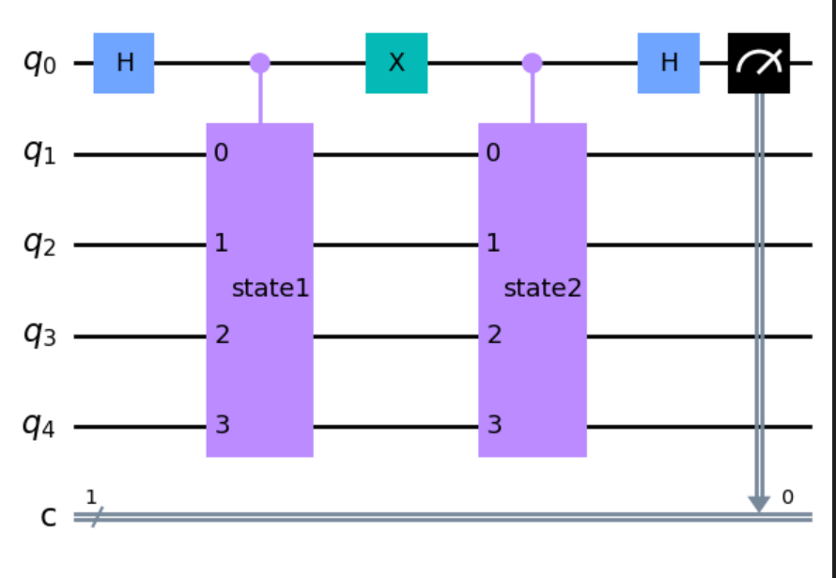

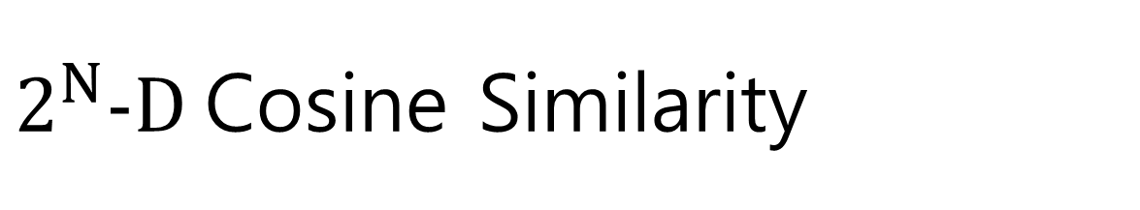


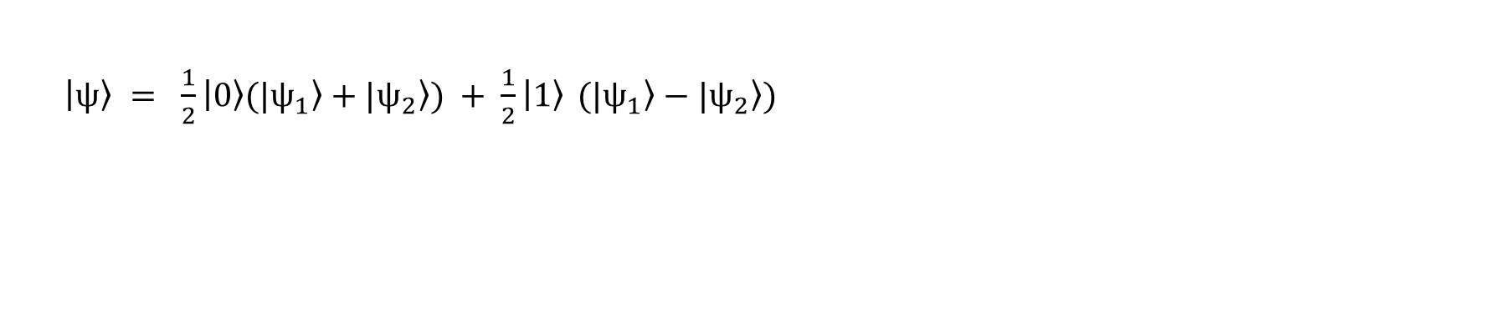
$2^{N}−D$Cosine Similarity
$\left.|ψ\right\rangle$=$\left[\begin{matrix}\begin{matrix}x_{1} \\ x_{2} \\ x_{3}\end{matrix} \\ x_{4} \\ \begin{matrix}x_{5} \\ \begin{matrix}x_{6} \\ x_{7}\end{matrix} \\ x_{8}\end{matrix}\end{matrix}\right]$
Idea
Consider the quantum state as a state vector
$\left\langle ψ_{2} | ψ_{1}\right\rangle$ is $cos(θ)$ between two states
because two vectors are normalized
How can we get inner product value by measuring quantum state?
$\left.\left|ψ\right.\right\rangle = \frac{1}{2}\left.\left|0\right.\right\rangle \left.(|ψ_{1}\right\rangle +\left.|ψ_{2}\right\rangle ) + \frac{1}{2}\left.\left|1\right.\right\rangle$ $\left.(|ψ_{1}\right\rangle −\left.|ψ_{2}\right\rangle )$
$$P_{0}=\left|{c_{0}}^{2}\right|$$
$$=\frac{1}{4}\left(\left\langle ψ_{1} | ψ_{1}\right\rangle +\left\langle ψ_{1} | ψ_{2}\right\rangle +\left\langle ψ_{2} | ψ_{1}\right\rangle +\left\langle ψ_{2} | ψ_{2}\right\rangle \right)$$
$$=\frac{1}{4}\left(2+2Re(\left\langle ψ_{1} | ψ_{2}\right\rangle )\right)$$
$$=\frac{1}{2}\left(1+Re(\left\langle ψ_{1} | ψ_{2}\right\rangle )\right)$$
ancilla
state

Slide 6
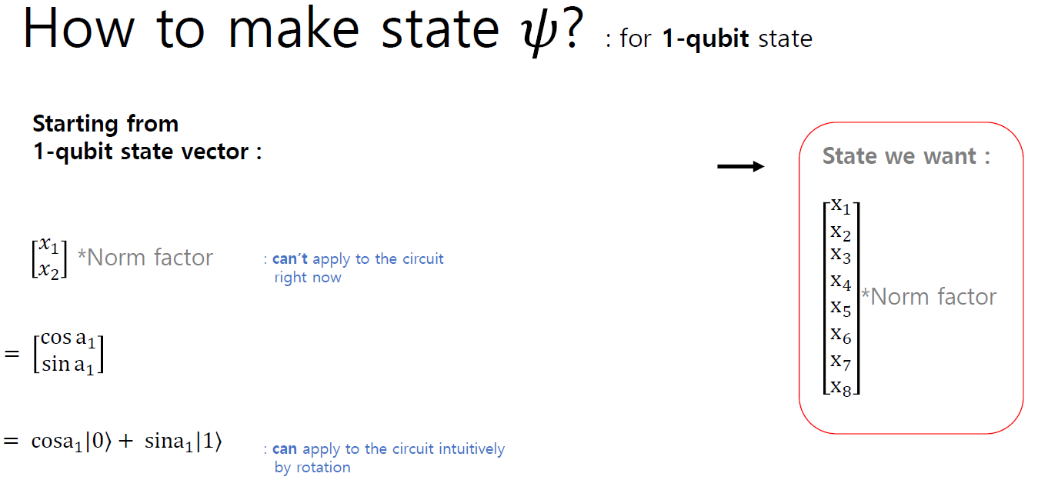

Slide 7
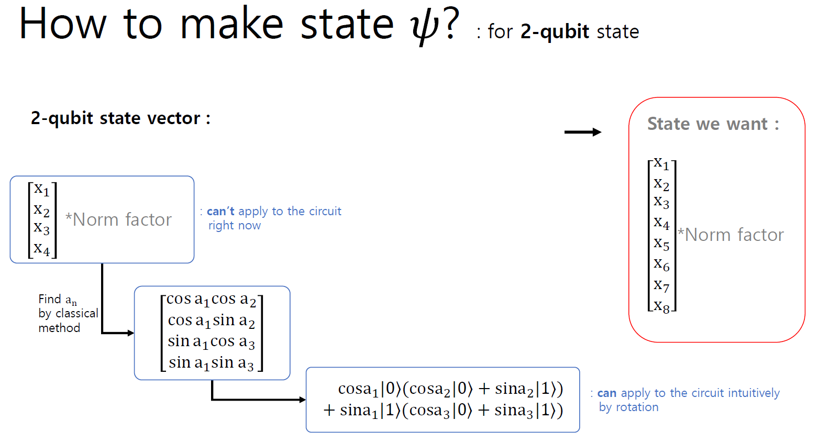

Slide 8
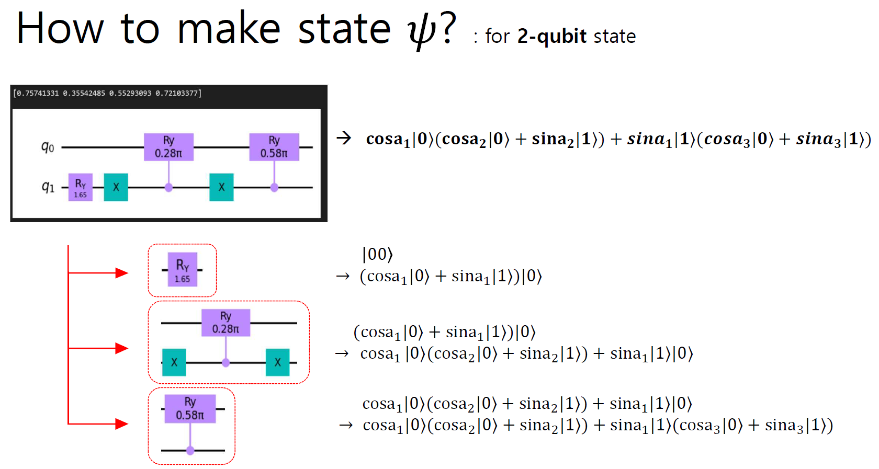
Notes:
자유도 : 변수 개수 빼기 바운더리 조건

Slide 9
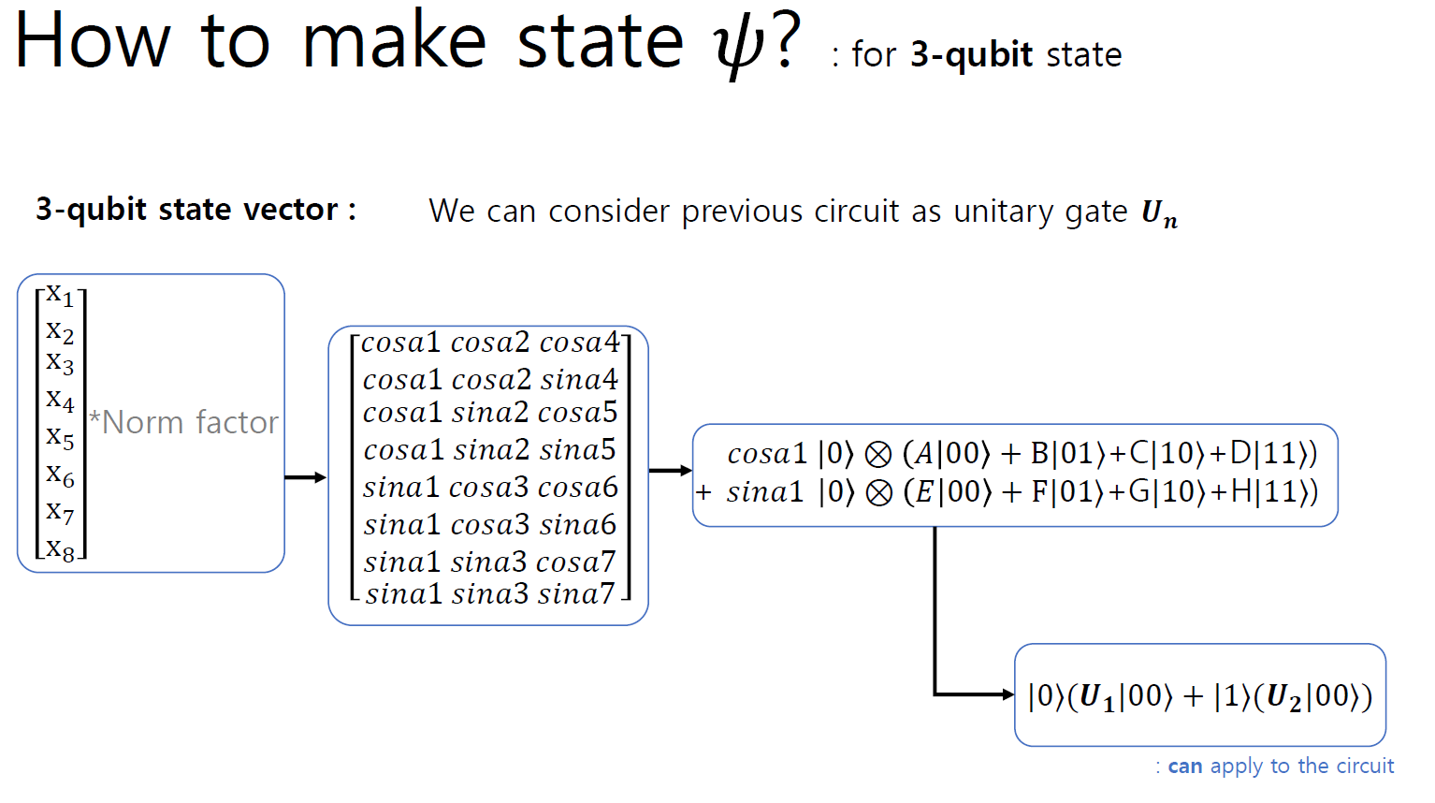



$$|0⟩⊗|two qubit state⟩$$
$$0$$
$$|1⟩⊗|two qubit state⟩$$

Slide 10
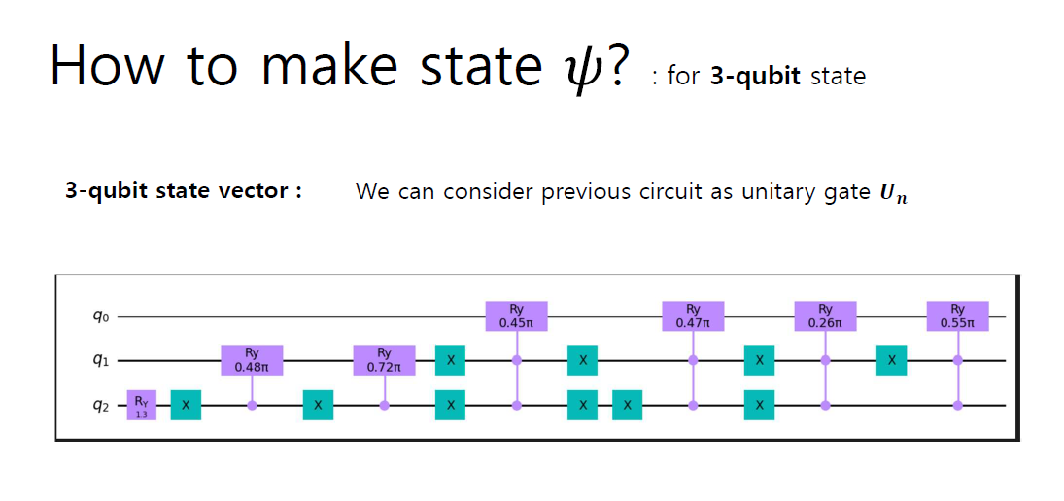

Slide 11
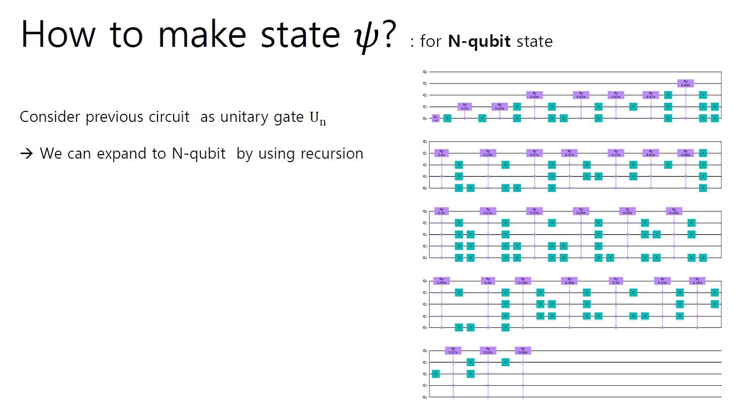

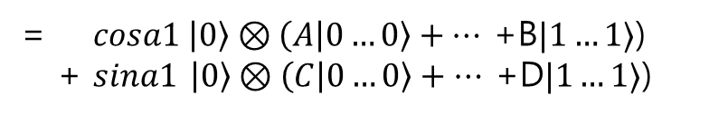

$$\left[\begin{matrix}x_{1} \\ x_{2} \\ \begin{aligned}x_{3} \\ x_{4} \\ ⋮ \\ ⋮ \\ ⋮ \\ x_{2^{n}}\end{aligned}\end{matrix}\right] = \left[\begin{matrix}\begin{aligned}cosa1 cosa2…cosa4 \\ cosa1 cosa2…sina4\end{aligned} \\ \begin{aligned}cosa1 sina2…cosa5 \\ ⋮ ⋮ ⋮ \\ ⋮ … cosa2^{n−2} \\ ⋮ … sina2^{n−2} \\ ⋮ … cosa2^{n−1}\end{aligned} \\ sina1 … sina2^{n−1}\end{matrix}\right]$$
= $cosa1 \left|0\right\rangle ⊗\left(A | 0…0\right\rangle +…$ +B$|1…1⟩$)
+ $sina1 \left|0\right\rangle ⊗\left(C | 0…0\right\rangle +… \text{+}\text{D}|1…1⟩\text{)}$
$$= |0⟩(U_{1}|0…0⟩+|1⟩(U_{2}|0…0⟩)$$

Slide 12
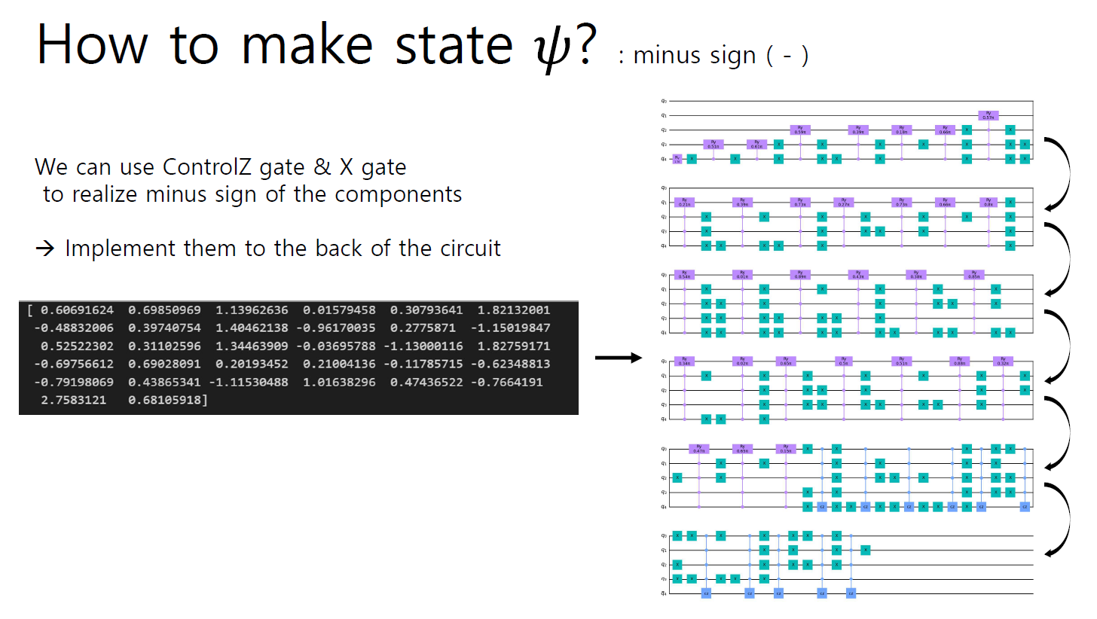
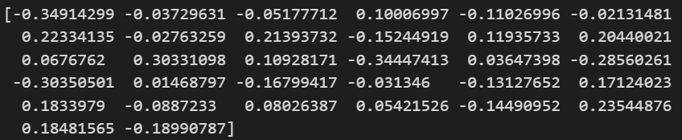
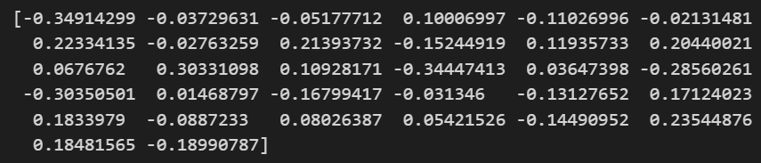
State Input
State Output

Slide 13
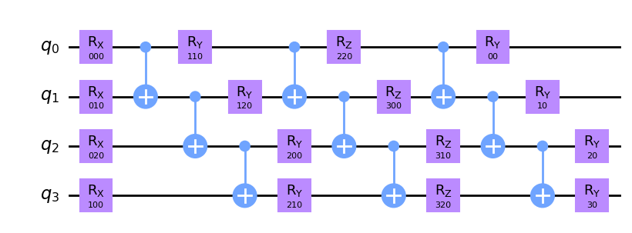
How to make state $ψ$? : for N-qubit state
But the previous circuit shows high circuit depth.
How do we make an arbitrary state while reducing the circuit depth? (Comment from Mentor)
➔ Using Ansatz
Notes:
저번까지 구현한 circuit의 문제점 (멘토의 코멘트)과 이를 해결하기 위해 도입한 Ansatz

Slide 14
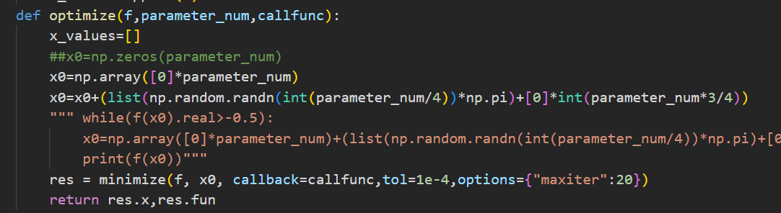
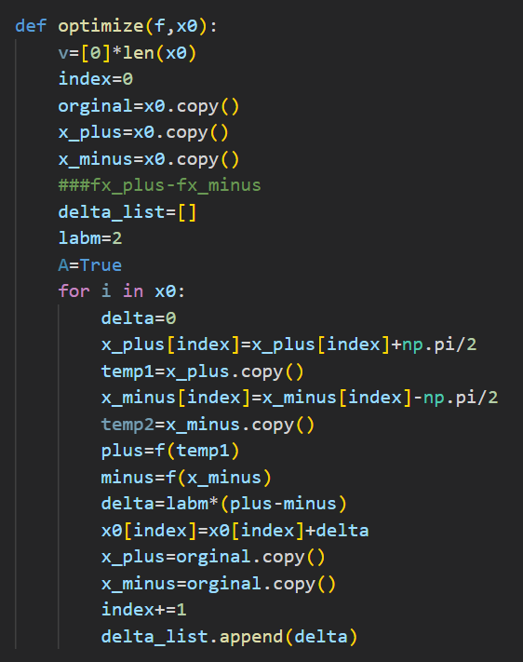
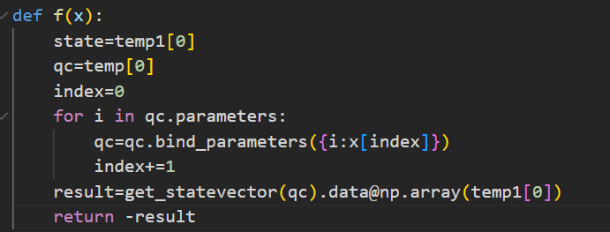
How to identify the state? : Quantum tomography
Optimizer 1
State vector simulation
Optimizer 2
$\frac{∂\hat{f}(θ)}{∂θ_{r}}={\hat{f}}_{θ_{r}}^{+}−{\hat{f}}_{θ_{r}}^{−}$
${\hat{f}}_{θ_{r}}^{±}=\hat{f}(θ_{1}, ⋯θ_{r−1},θ_{r}±\frac{π}{2},θ_{r+1}, ⋯θ_{R})$
Reference : Mitsuda, N., Nakaji, K., Suzuki, Y., Tanaka, T., Raymond, R., Tezuka, H., ... & Yamamoto, N. (2022). Approximate complex amplitude encoding algorithm and its application to classification problem in financial operations. arXiv preprint arXiv:2211.13039.
Notes:
임의의 state를 구현했으니, 다음은 우리가 원하는 state인지 확인하는 과정이 필요.
이를 위해 quantum tomography를 진행하기 위해 2가지 다른 방법을 이용.
첫번째는 BFGS optimizer, 두번째는 reference(어떤 reference인지 확인)
(Quantum tomography란 동일한 양자 상태 앙상블을 여러가지 측정을 통해, 정확하게 재구성하는 과정)

Slide 15
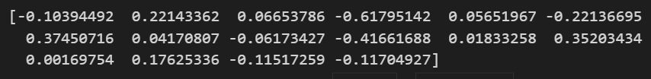
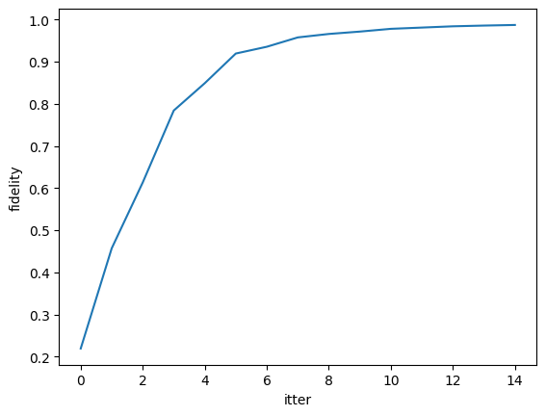
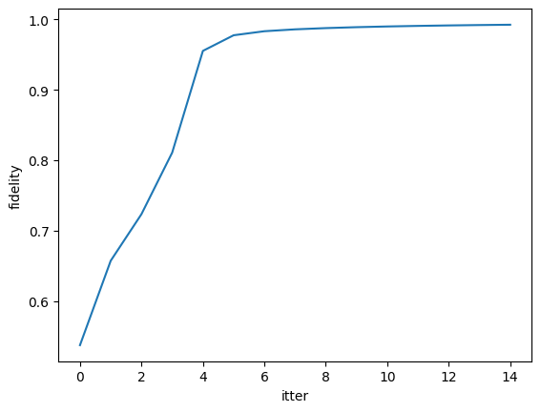
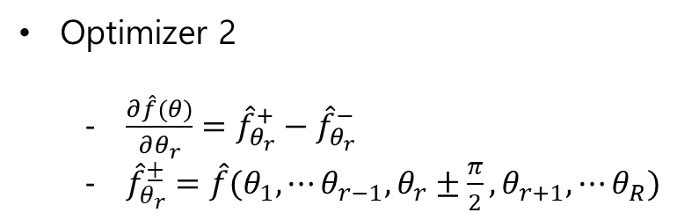
Optimizer 1
State vector simulation
Optimizer 2
$\frac{∂\hat{f}(θ)}{∂θ_{r}}={\hat{f}}_{θ_{r}}^{+}−{\hat{f}}_{θ_{r}}^{−}$
${\hat{f}}_{θ_{r}}^{±}=\hat{f}(θ_{1}, ⋯θ_{r−1},θ_{r}±\frac{π}{2},θ_{r+1}, ⋯θ_{R})$

Slide 16
How to compute in quantum computer?
Problem 1
In quantum computer, any measurement can have different result data slightly even if the state is same.(Result comes form Gaussian function!) That makes we can’t use differenciate approximation.
Problem 2
Tomography is accompanied by exponential measurement. So it is needed to reduce the measurement sets.
To resolve this-> we use classical shadow.
We are going to get data with that method.
Notes:
같은 state에 대해 optimizer 1과 optimizer 2의 비교 (1)

Slide 17
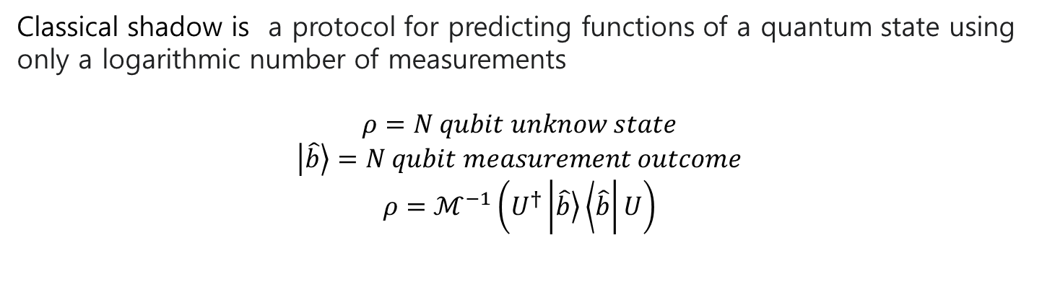



What is classical shadow?
Classical shadow is a protocol for predicting functions of a quantum state using only a logarithmic number of measurements
$$ρ=N qubit unknow state$$
$$\left|\left.\hat{b}\right\rangle \right.=N qubit measurement outcome$$
$$ρ=ℳ^{−1}\left(U^{†}\left|\left.\hat{b}\right\rangle \left\langle \hat{b}\right.\right|U\right)$$
Deal with classical
Ansatz
arbitrary
U
$${\text{(}\text{arbitrary} \text{U})}^{†}$$
$$ρ$$
$$\hat{b}$$
Reference : Mitsuda, N., Nakaji, K., Suzuki, Y., Tanaka, T., Raymond, R., Tezuka, H., ... & Yamamoto, N. (2022). Approximate complex amplitude encoding algorithm and its application to classification problem in financial operations. arXiv preprint arXiv:2211.13039.

Slide 18
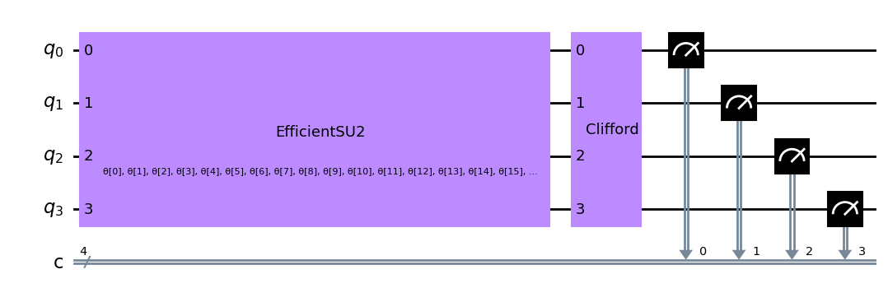
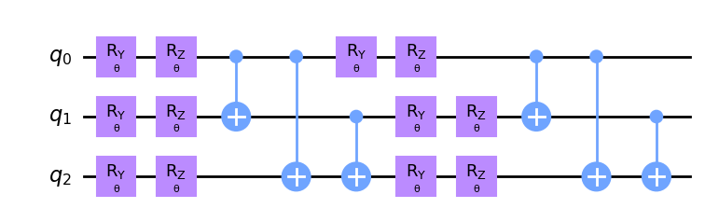
What is classical shadow?
EX) rep 2
Arbitrary Clifford set

Slide 19
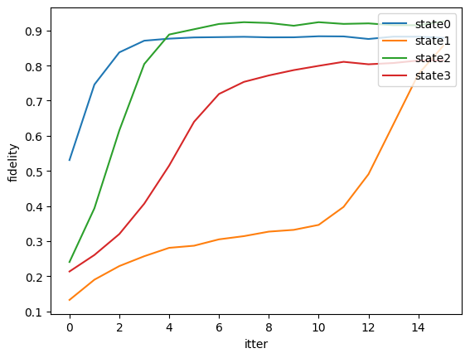
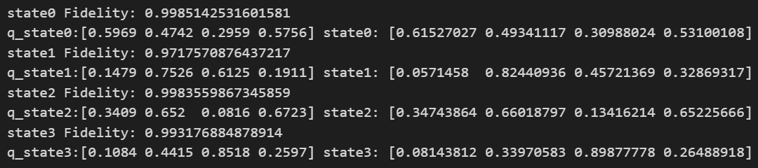

Classical shadow result
The number of qubit : 2
The number of unitary set : 20
Repetition : 16
F factor
f factor $∝$ fidelity
Q state : predicted state
State : original state
Notes:
F factor : measurement 채널이 있는데, measurement 채널이란 measurement 했을 때 가능한 set들의 집합. 이 집합이 얼마나 data quantum channel set이 비슷한가를 나타낸 지표.
State가 data, q state가 서킷으로 만든 state

Slide 20
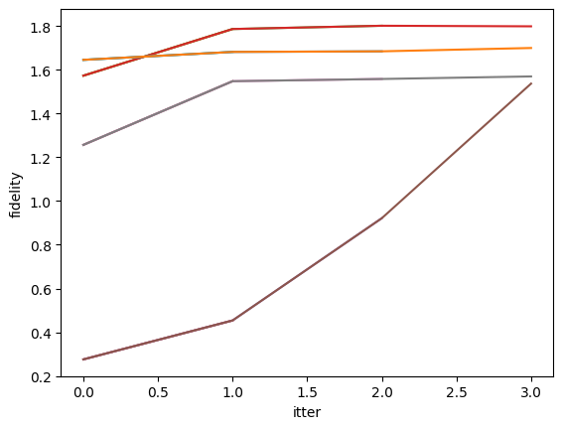
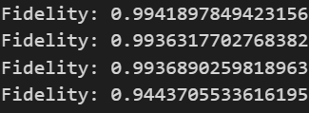
Classical shadow result
The number of qubit : 2
The number of unitary set : 20
Repetition : 4
F factor

Slide 21
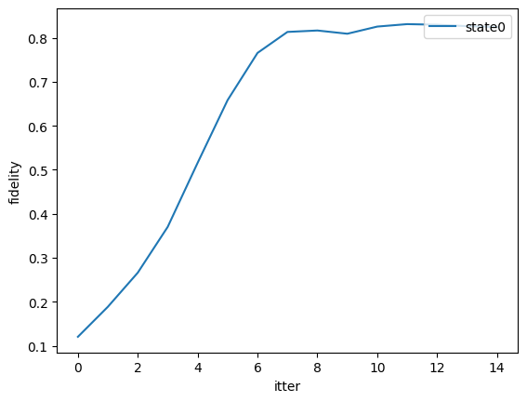
Classical shadow result
The number of qubit : 4
The number of unitary set : 40
Repetition : 2
F factor
state0 Fidelity: (0.8255915176866326)

Slide 22
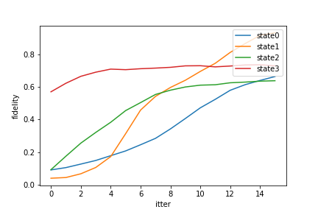
Classical shadow result
The number of qubit : 4
The number of unitary set : 100
Repetition : 2
F factor
state Fidelity:
(0.8121863700133204)
(0.9208233542882074)
(0.8072498923247862)
(0.877711773889788)
AVG : 85%

Slide 23
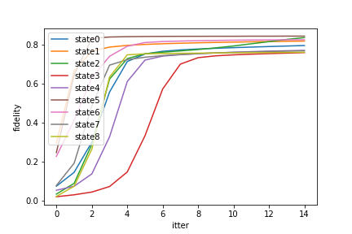
The number of qubit : 4
The number of unitary set : 200
Repetition : 2
state Fidelity:
(0.9584750235550221)
(0.9325920045261986)
(0.8072498923247862)
(0.9007945848862786)
AVG : 91%
(0.9290193069719797)
(0.8955187368981583)
(0.9070636703536302)

Slide 24
Classical shadow result
state Fidelity:
(0.9584750235550221)
(0.9325920045261986)
(0.8072498923247862)
(0.9007945848862786)
(0.9290193069719797)
(0.8955187368981583)
(0.9070636703536302)
Problem 1 : We can see that the more qubit, the lower fidelity. we try to do more unitary gate set, and it is improved. But excessive number of unitary gate set need too much time.
Therefore we need to define well to make the number of unitary gate set.

Slide 25
Cosine similarity discriminator
Describing data set information
$$|index>|state>|1 or −1>$$
Index : index number of information
State : state of information
Part (1 or -1) : discriminate factor of information

Slide 26

Cosine similarity discriminator
Describing information
$$|index>|state>|1 or −1>$$
Ex) we wanna discriminate Cat!
We have dataset like [|0>|cat_0>|1>, |1>|cat_1>|1>, |2>|not cat_0>|-1>, |3>|not cat_1>|-1>]
If new information is inserted, we calculate dot product (all data & new information) and then finally we got the result of discriminator.
$Σ$
New data :
|i>|new information>|->

Slide 27
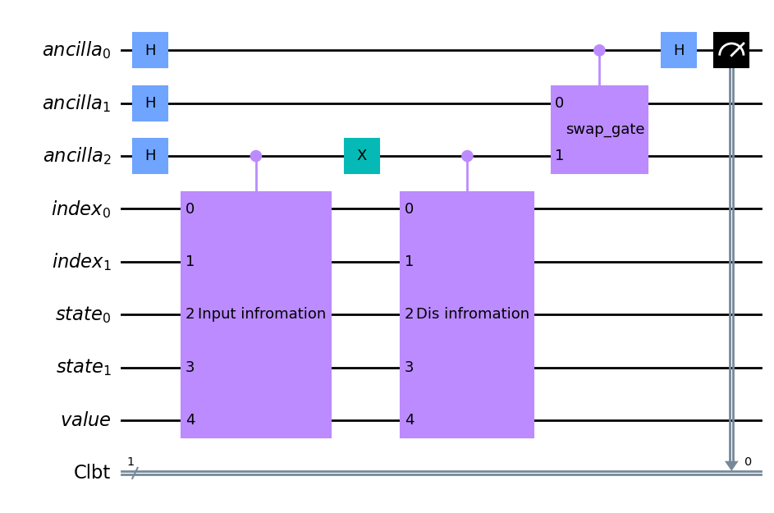
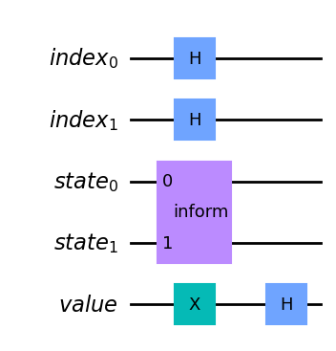
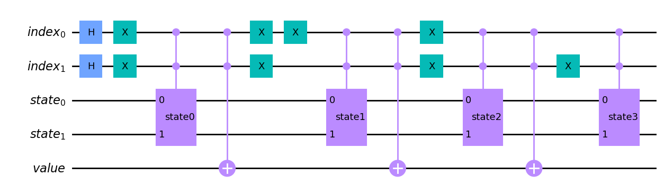

Cosine similarity discriminator
Reference : Pastorello, D., & Blanzieri, E. (2021, October). A quantum binary classifier based on cosine similarity. In 2021 IEEE International Conference on Quantum Computing and Engineering (QCE) (pp. 477-478). IEEE.
$Σ$
|i>|new information>|->
[|0>|cat_0>|1>, |1>|cat_1>|1>, |2>|not cat_0>|-1>, |3>|not cat_1>|-1>]
Notes:
|0>|state0>|1>+|1>|state0>|1>+|2>|state0>|1>+|3>|state0>|0>
앞에 3개는 고양이 아닌 state, 4번째 state는 고양이 state, 0이라서 뒤에 아무 게이트 없음.

Slide 28
Cosine similarity discriminator
Dataset : ([[0.41542971, 0.2078856, 0.81741824, 0.34063053],-1]
, [[0.15540397 ,0.9684039 ,0.17537604, 0.08536238],1]
, [[0.11048024 ,0.99382308, 0.00314644, 0.00999475], 1],
[[0.41140646, 0.28830002, 0.8051889 , 0.3151169 ],-1]])
New information : ( [0.25213438, 0.22939302, 0.90214053, 0.95855015])
Quantum Circuit : 0.041685267857142855
Classical : 0.03954057729402208

Slide 29
Classical vs Quantum
What is more proper to calculate cosine similarity?
Classical method outperform compared to quantum way. But if we can prepare quantum state well, then it might be efficient to use quantum computer.
Notes:
계산 병렬 처리가 가능하기 때문

